Slide 1
CENG 538 Advanced Graphics and UIs
Forward Rendering Pipeline Clipping and Culling

Slide 2
Rendering Pipeline
Sequence of operations that is used to draw primitives defined in a 3D coordinate system on a 2D window
Can be implemented on hardware or software
Two notable APIs: OpenGL and D3D
Not static: Constantly evolving to meet the demands of the industry
Rendering
Pipeline
2D Window
3D World

Slide 3
Rendering Pipeline – Overview
Vertices
Pixels
Get vertices in specific order and connectivity information
Process vertices
Create primitives from connected vertices
Clip and cull primitives to eliminate invisible ones
Transform primitives to screen space (preserve z)
Rasterize primitives to obtain fragments
Process fragments to obtain visible pixels with color
Vertex Processing
Fragment Processing
Transformed vertices
Fragments
Primitive Assembly
Rasterization
Primitives
Clipping and Culling
Primitives with 2D
coordinates and z
Viewport Transform
Visible primitives

Slide 4
Until Now
Vertices
Pixels
We’ve done transformations: model to world to camera to clip space
We skip over primitive assembly as it is mostly straightforward
We’ll look at clipping and culling today
We’ve done viewport transformations
Yet to come rasterization: lines, triangles, interpolation
Yet to come fragment processing (blending, depth testing, alpha testing, etc) afterwards
Vertex Processing
Fragment Processing
Transformed vertices
Fragments
Primitive Assembly
Rasterization
Primitives
Clipping and Culling
Primitives with 2D
coordinates and z
Viewport Transform
Visible primitives

Slide 5
Clipping
In modern graphics API, there are essentially three kinds of primitives: points, lines, and triangles
Point clipping: straightforward
Reject a point if its coordinates are outside the viewing volume
Line clipping
Cohen-Sutherland algorithm
Liang-Barsky algorithm
Polygon clipping
Sutherland-Hodgeman algorithm

Slide 6

Clipping
Clipping is done in the clip space which is a result of applying projection (orthographic or perspective) transformation
After perspective transformation the w component of a point becomes equal to –z
$$M_{per}= \left[\begin{matrix}\frac{2n}{r −l} & 0 & \frac{r+l}{r −l} & 0 \\ 0 & \frac{2n}{t −b} & \frac{t+b}{t −b} & 0 \\ 0 & 0 & −\frac{f+n}{f−n} & −\frac{2fn}{f −n} \\ 0 & 0 & −1 & 0\end{matrix}\right]$$

Slide 7
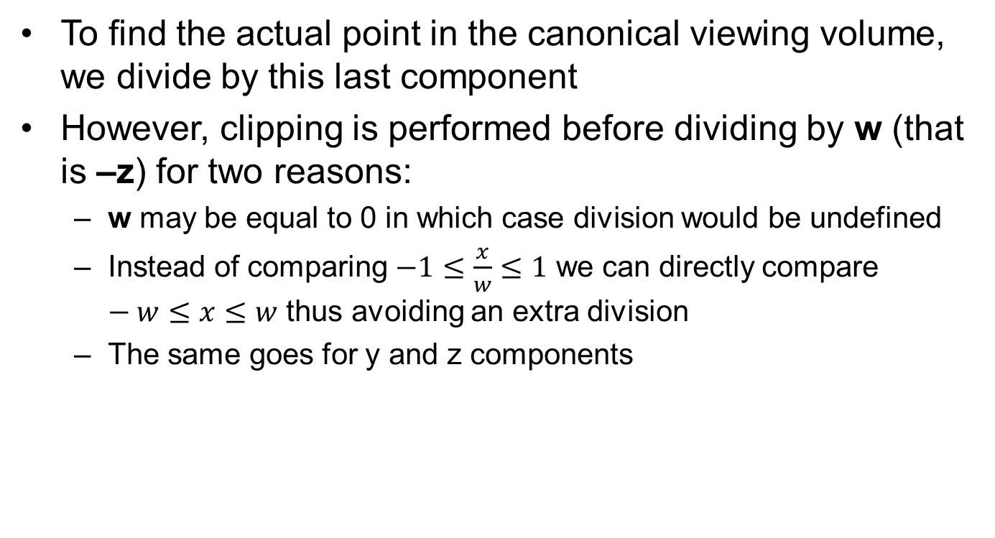
Clipping
To find the actual point in the canonical viewing volume, we divide by this last component
However, clipping is performed before dividing by w (that is –z) for two reasons:
w may be equal to 0 in which case division would be undefined
Instead of comparing $−1≤\frac{x}{w}≤1$ we can directly compare $−w≤x≤w$ thus avoiding an extra division
The same goes for y and z components

Slide 8
Clipping
For simplicity, however, in the following we assume that clipping is performed against a 2D box with coordinates between [x_{min}, x_{max}] and [y_{min}, y_{max}]
The same ideas can be easily generalized to 3D

Slide 9
Line Clipping – Cohen-Sutherland Alg.
Handle trivial accept and trivial rejects first
For non-trivial cases, subdivide lines until all parts can be trivially accepted and rejected
Trivial accept/reject lines
Non-trivial cases

Slide 10
Line Clipping – Cohen-Sutherland Alg.
Assign region codes to the end points of lines:
Bit0 = 1 if region is to the left of left edge, 0 otherwise
Bit1 = 1 if region is to the right of right edge, 0 otherwise
Bit2 = 1 if region is below the bottom edge, 0 otherwise
Bit3 = 1 if region is above the top edge, 0 otherwise
1001
1000
1010
How many regions
would we have in 3D?
How many bits
would we need?
0001
0000
0010
0101
0100
0110
Notes:
We have 27 regions in three 3D
So at minimum we need 5 bits. But to apply the exact same algorithm we need 6 bits because each bit indicates whether we are inside or outside with respect to a given face. And we have 6 faces of our viewing volume.

Slide 11
Line Clipping – Cohen-Sutherland Alg.
Assign the codes to the end points of the line:
c_{v0} = 0001
c_{v1} = 1010
If both codes are zero, the line can be trivially accepted
If bitwise and of region codes is not zero, then the line can be trivially rejected
1001
1000
1010
v1
0001
0000
0010
v0
0101
0100
0110

Slide 12
Line Clipping – Cohen-Sutherland Alg.
Non-trivial cases:
Iteratively subdivide into two segments such that one or both segments can be discarded, until we can trivially reject or accept it
Intersection of the outpoint and extended viewport border is computed (i.e. with the parametric equation for the line) and this new point replaces the outpoint
1001
1000
1010
v1
1001
1000
1010
v1
0001
0000
0010
0001
0000
0010
v0
v0
0101
0100
0110
0101
0100
0110

Slide 13
Line Clipping – Cohen-Sutherland Alg.
Non-trivial cases:
Iteratively subdivide into two segments such that one or both segments can be discarded, until we can trivially reject or accept it
Intersection of the outpoint and extended viewport border is computed (i.e. with the parametric equation for the line) and this new point replaces the outpoint
1001
1000
1010
v1
1001
1000
1010
v1
v'1
0001
v'0
0000
0010
0001
v'0
0000
0010
no trivial
rejection
0101
0100
0110
0101
0100
0110

Slide 14
Line Clipping – Cohen-Sutherland Alg.
Advantages:
If the chances of trivial accept/reject are high, this is a very fast algorithm
This can happen if the clipping rectangle is very large or very small
Disadvantages:
Non-trivial lines can take several iterations to clip
Because testing and clipping are done in a fixed order, the algorithm will sometimes perform needless clipping

Slide 15
Line Clipping – Liang-Barsky Algorithm
Uses the idea of parametric lines
Classifies lines as potentially entering and potentially leaving to speed up computation (approximately 40% speed-up over Cohen-Sutherland Alg.)
Line equation: p = v0 + (v1-v0)t
y_{max}
t_{l}
t_{l}
t of interest?
t_{e}
t_{e}
y_{min}
x_{min}
x_{max}

Slide 16
Line Clipping – Liang-Barsky Algorithm
Uses the idea of parametric lines
Classifies lines as potentially entering and potentially leaving to speed up computation (approximately 40% speed-up over Cohen-Sutherland Alg.)
Line equation: p = v0 + (v1-v0)t
y_{max}
t_{l}
t_{l}
t of interest
LARGEST t_{e}
SMALLEST t_{l}
t_{e}
t_{e}
y_{min}
x_{min}
x_{max}

Slide 17
Line Clipping – Liang-Barsky Algorithm
Uses the idea of parametric lines
Classifies lines as potentially entering and potentially leaving to speed up computation (approximately 40% speed-up over Cohen-Sutherland Alg.)
Line equation: p = v0 + (v1-v0)t
reject if _______?
y_{min}
x_{min}
x_{max}

Slide 18
Line Clipping – Liang-Barsky Algorithm
Uses the idea of parametric lines
Classifies lines as potentially entering and potentially leaving to speed up computation (approximately 40% speed-up over Cohen-Sutherland Alg.)
t_{e}
Line equation: p = v0 + (v1-v0)t
t_{l}
reject if t_{e} > t_{l}
y_{min}
x_{min}
x_{max}

Slide 19
Line Clipping – Liang-Barsky Algorithm
Uses the idea of parametric lines
Classifies lines as potentially entering and potentially leaving to speed up computation (approximately 40% speed-up over Cohen-Sutherland Alg.)
v₁ = (x₁, y₁)
y_{max}
Goal: Given the line v0, v1 determine:
- The part of the line is inside the viewing rectangle.
p = (x, y)
v₀ = (x₀, y₀)
Note: p = v0 + (v1-v0)t
y_{min}
x_{min}
x_{max}

Slide 20
Line Clipping – Liang-Barsky Algorithm
Potentially entering (PE) and leaving (PV):
Why do we say potentially?
v₀,v₁ is potentially entering
the left edge as x₁ – x₀ > 0
v₂,v₃ is potentially leaving
the left edge as x₃ – x₂ < 0
v₃
v₇
v₁
v₅
The situation is reversed for
the right edge:
v₀
v₂
v₆
v₄
v₄,v₅ is potentially leaving
the right edge as x₅ – x₄ > 0
v₆,v₇ is potentially entering
the right edge as x₇ – x₆ < 0
Left
Right

Slide 21
Line Clipping – Liang-Barsky Algorithm
Similar for bottom and top edges:
v₆
v₀,v₁ is potentially entering
the bottom edge as y₁ – y₀ > 0
v₂,v₃ is potentially leaving
the bottom edge as y₃ – y₂ < 0
Top
v₅
The situation is reversed for
the top edge:
v₄
v₇
v₂
v₁
Bottom
v₄,v₅ is potentially leaving
the top edge as y₅ – y₄ > 0
v₆,v₇ is potentially entering
the top edge as y₇ – y₆ < 0
v₀
v₃

Slide 22
Line Clipping – Liang-Barsky Algorithm
Observation: If a line is first leaving then entering, it cannot be visible
PE
v₁
v₁
PE
PL
PL
v₀
v₀
v₁
v₁
PE
PE
PL
PL
v₀
v₀

Slide 23
Line Clipping – Liang-Barsky Algorithm
Visible lines are first entering then leaving:
PL
v₁
v₁
PL
PE
PE
v₀
v₀
v₁
v₁
PL
PL
PE
PE
v₀
v₀

Slide 24
Line Clipping – Liang-Barsky Algorithm
Mathematical interpretation:
So at intersection points, we need to compute the t value as well as whether the line is PE or PL at that point.
if (t_{PL} < t_{PE}):
visible = false;
Note: p = v0 + (v1-v0)t
PE
v₁
v₁
PL
v₁
v₁
PL
PL
PE
PL
PE
PE
v₀
v₀
v₀
v₀
v₁
v₁
PL
PL
v₁
v₁
PE
PE
PE
PE
v₀
v₀
PL
PL
v₀
v₀

Slide 25
Line Clipping – Liang-Barsky Algorithm
Computing t value at every edge:
But this does not help us to know if line is entering or leaving at that point. Solution: look at the sign of dx, dy:
x_{left} = x0 + (x1-x0)t ➔ t = (x_{left} – x0) / (x1 – x0)
x_{right} = x0 + (x1-x0)t ➔ t = (x_{right} – x0) / (x1 – x0)
y_{bottom} = y0 + (y1-y0)t ➔ t = (y_{bottom} – y0) / (y1 – y0)
y_{top} = y0 + (y1-y0)t ➔ t = (y_{top} – y0) / (y1 – y0)
v₀,v₁ is potentially entering
the left edge if dx = (x₁ – x₀) > 0
v₀,v₁ is potentially entering
the right edge if dx = (x₁ – x₀) < 0
or –dx > 0
v₀,v₁ is potentially entering
the bottom edge if dy = (y₁ – y₀) > 0
v₀,v₁ is potentially entering
the top edge if dy = (y₁ – y₀) < 0
or –dy > 0

Slide 26
Line Clipping – Liang-Barsky Algorithm
Finding intersection type:
Entering left edge if dx > 0.
Entering right edge if -dx > 0.
Entering bottom edge if dy > 0.
Entering top edge if -dy > 0.
Finding t:
For left edge: t = (x_{left} – x₀) / (x₁ – x₀) = (x_{left} – x₀) / dx
For right edge: t = (x_{right} – x₀) / (x₁ – x₀) = (x_{right} – x₀) / dx = (x0 – x_{right}) / (-dx)
For bottom edge: t = (y_{bottom} – y₀) / (y₁ – y₀) = (y_{left} – y₀) / dy
For top edge: t = (y_{top} – y₀) / (y₁ – y₀) = (y_{top} – y₀) / dy = (y0 – y_{top}) / (-dy)

Slide 27
Line Clipping – Liang-Barsky Algorithm
For lines parallel to edges:
if d_{x} == 0 and x_{min} – x₀ > 0: // left
reject;
else if d_{x} == 0 and x₀ - x_{max} > 0: // right
reject;
else if d_{y} == 0 and y_{min} – y₀ > 0: // bottom
reject;
else if d_{y} == 0 and y₀ - y_{max} > 0: // top
reject;
v₁ = (x₁, y₁)
y_{max}
v₀ = (x₀, y₀)
y_{min}
x_{min}
x_{max}

Slide 28
Line Clipping – Liang-Barsky Algorithm
Putting it all together:
bool visible(den, num, t_{E}, t_{L}):
if (den > 0): // potentially entering
t = num / den;
if (t > t_{L}):
return false;
if (t > t_{E})
t_{E} = t;
else if (den < 0): // potentially leaving
t = num / den;
if (t < t_{E}):
return false;
if (t < t_{L})
t_{L} = t;
else if num > 0: // line parallel to edge
return false;
return true;
t_{E} = 0; t_{L} = 1;
visible = false;
if visible(d_{x}, x_{min} – x_{0.} t_{E,} t_{L}): // left
if visible (-d_{x}, x₀ – x_{max .} t_{E,} t_{L}): // right
if visible (d_{y}, y_{min} – y_{0 .} t_{E,} t_{L}): // bottom
if visible (-d_{y}, y₀ – y_{max .} t_{E,} t_{L}): // top
visible = true;
if (t_{L} < 1):
x₁ = x₀ + d_{x}t_{L};
y₁ = y₀ + d_{y}t_{L};
if (t_{E} > 0):
x₀ = x₀ + d_{x}t_{E};
y₁ = y₀ + d_{y}t_{E};

Slide 29
Example
Left Edge
v₁
v₁
v₀
v₀
PE with small positive t (t_{E} = t)
Right Edge
v₁
PL with large positive t (t_{L} = t)
v₀

Slide 30
Example
Bottom Edge
v₁
v₁
v₀
v₀
PE with negative t (t_{E} not updated)
Top Edge
PL with t > 1 (t_{L} not updated)
v₁
v₀

Slide 31
Example
Result
v₁
Smallest t_{L}
v₀
Largest t_{E}

Slide 32
Polygon Clipping – Sutherland Hodgeman Algorithm
Difficult problem as we need to deal with many cases:

Slide 33
Polygon Clipping – Sutherland Hodgeman Algorithm
Divide and conquer approach makes it manageable:
Solve a series of simple and identical problems.
When combined, the overall problem is solved.
Here, the simple problem is to clip a polygon against a single clip edge:
Clip against right edge

Slide 34
Polygon Clipping – Sutherland Hodgeman Algorithm
Clip against bottom edge
Clip against left edge

Slide 35
Polygon Clipping – Sutherland Hodgeman Algorithm
Clip against top edge

Slide 36
Polygon Clipping – Sutherland Hodgeman Algorithm
This is accomplished by visiting the input vertices from v₀ to v_{N} and then back to v₀ for each clip boundary.
At every step we add 0, 1, or 2 vertices to the output:
Inside
Outside
Inside
Outside
Inside
Outside
Inside
Outside
v_{i}
v_{i}
v_{i}
v_{i+1}
v_{i+1}
v_{i}
v'_{i+1}
v'_{i+1}
v_{i+1}
v_{i+1}
Add v_{i+1} to output
Add v’_{i+1} to output
Add nothing to output
Add v’_{i+1} and v_{i+1}to output

Slide 37
Polygon Clipping – Sutherland Hodgeman Algorithm
Inside
Outside
n
a
What is v’_{i+1}?
v_{i}
v_{i+1}
v'_{i+1}
Add v’_{i+1} to output

Slide 38
Polygon Clipping – Sutherland Hodgeman Algorithm
Inside
Outside
n
a
What is p = v’_{i+1}? Call v = v_{i} and w = v_{i+1}
p = v + t(w-v)
Denote d1 = n.(v-a) and d2 = n.(w-a)
p - a = (v-a) + t(w-a – (v-a)) //subtract a
n.(p - a) = n.(v-a) + t(n(w-a) – n(v-a)) //multiply by n
0 = d1 + t(d2 – d1)
t = d1 / (d1 – d2)
What if v is on the plane?
What if w is on the plane? Also, d1 is + (-), d2 is - (+)
v_{i}
v_{i+1}
v'_{i+1}
Add v’_{i+1} to output
Notes:
What if v is on the plane? d1 would be zero which makes t=0. Similarly, w on the plane makes t=1

Slide 39
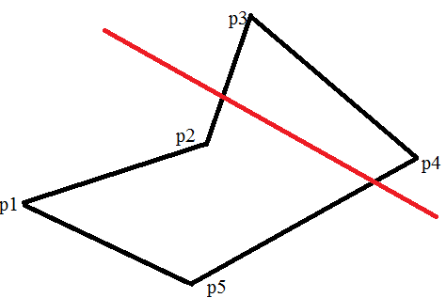
Polygon Clipping In Action
Maintain In and Out list, which will help you extract result
IN OUT
_{p1}
_{p2}

Slide 40
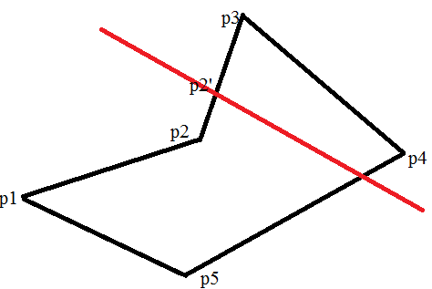
Polygon Clipping In Action
Maintain In and Out list, which will help you extract result
IN OUT
_{p1 p2’}
_{p2}
_{p2’}

Slide 41
Polygon Clipping In Action
Maintain In and Out list, which will help you extract result
IN OUT
_{p1 p2’}
_{p2 p3}
_{p2’ p4}

Slide 42
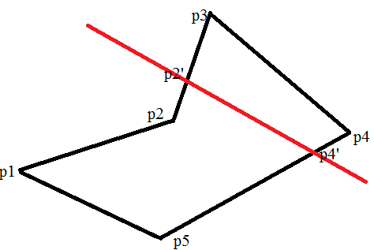
Polygon Clipping In Action
Maintain In and Out list, which will help you extract result
IN OUT
_{p1 p2’}
_{p2 p3}
_{p2’ p4}
_{p4’ p4’}
_{p5}

Slide 43
Culling
Complex scenes contains many objects.
Objects closer to the camera occlude objects further away.
Rendering time can be saved if these invisible objects are culled (i.e. eliminated, discarded, thrown away).
Three common culling strategies are:
View volume (frustum) culling
Backface culling
Occlusion culling

Slide 44
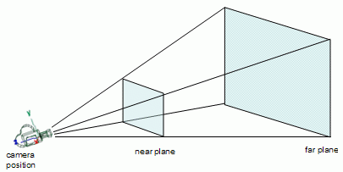
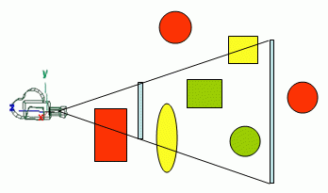
View Volume (Frustum) Culling
The removal of geometry outside the viewing volume.
No OpenGL support: it is the programmer’s responsibility to cull what is outside.
From lighthouse3d.com

Slide 45
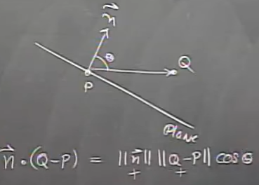
View Volume (Frustum) Culling
First determine the equations of the planes that make up the boundary of the view volume (6 planes):
Here, a is a point on the plane and n is the normal.
Plug the vertices of each primitive for p. If we get:
for any plane, the vertex is outside. If all vertices are
outside, then the primitive is outside and can be culled.
Using a bounding box or bounding sphere for complex models is a better solution.
Plane equation: (p – a).n = 0
(p – a).n > 0

Slide 46
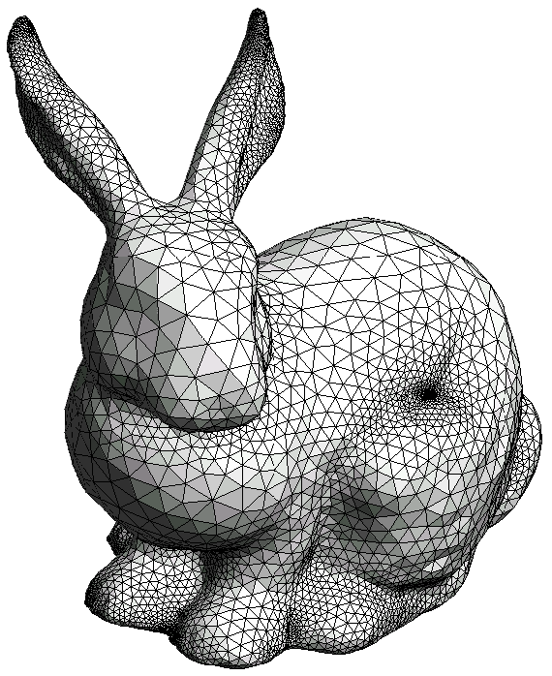
Backface Culling
For closed polygon models, back facing polygons are guaranteed to be occluded by front facing polygons (so they don’t need to be rendered)
OpenGL supports backface culling: glCullFace(GL_BACK) and glEnable(GL_CULL_FACE).
From http://wwwisg.cs.uni-magdeburg.de/~oscar

Slide 47
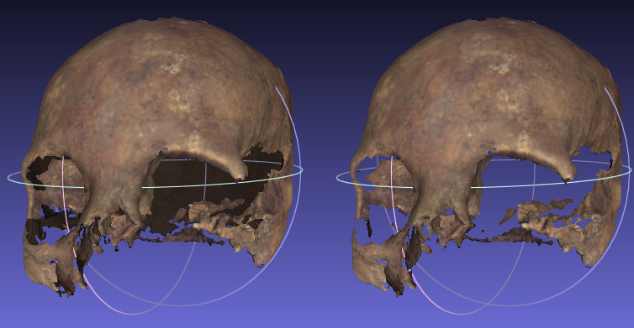
Backface Culling
For closed polygon models, back facing polygons are guaranteed to be occluded by front facing polygons (so they don’t need to be rendered)
OpenGL supports backface culling: glCullFace(GL_BACK) and glEnable(GL_CULL_FACE).
Without BFC With BFC

Slide 48
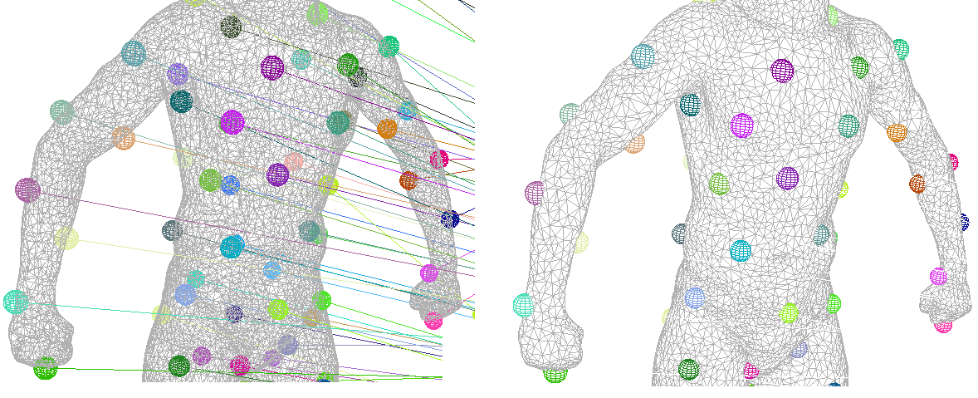
Backface Culling
For closed polygon models, back facing polygons are guaranteed to be occluded by front facing polygons (so they don’t need to be rendered)
Also useful in hidden line removal
Wireframe Hidden lines removed

Slide 49
Backface Culling
Polygons whose normals face away from the eye are called back facing polygons.
v₂
v₀
w
w
v
n
v
eye
eye
n
v
v
v₁
v₁
v₀
v₂
Front facing triangle
n.v < 0
Back facing triangle
n.v > 0

Slide 50
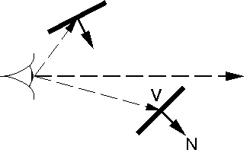
Backface Culling
Note the v is the vector from the eye to any point on the polygon (you can take the polygon center). You cannot use the view vector!
w
From http://omega.di.unipi.it

Slide 51
Occlusion Culling
The removal of geometry that is within the view volume but is occluded by other geometry closer to the camera:
OpenGL supports occlusion queries to assist the user in occlusion culling (aka Z-culling).
This is commonly used in games but a bit advanced for the purposes of this class.
w
Red triangle is occluded
by the blue triangle.
eye

Slide 52
Occlusion Culling in OpenGL
Create a query.
Disable rendering to screen (set the color mask of all channels to False).
Disable writing to depth buffer (just test against, but don't update, the depth buffer).
Issue query begin (which resets the counter of visible pixels).
"Render" the object's bounding box (it'll only do depth testing; pixels that pass depth testing will not be rendered on-screen because rendering and depth writing were disabled).
End query (stop counting visible pixels).
Enable rendering to screen.
Enable depth writing (if required).
Get query result (the number of "visible" pixels).
If the number of visible pixels is greater than 0 (or some threshold),
Render the complete object.
For details see: http://http.developer.nvidia.com/GPUGems/gpugems_ch29.html

